Slide 1
Cloud Computing
Features and Advantages
Chandi Charan Mahato
Anurag Varshney
Divyanshu Gupta
Harish
Professional Communication Lab
Galgotias College Of Engineering and Technology

Slide 2
What Is An Cloud Computing?
Brief intro about Cloud Computing.
Why We Use Cloud Computing?
Uses and its advantages.
Contents
Models of Cloud and its types
Deployment and Service Model , Types Private, Public, Hybrid, Community, IaaS, PaaS, SaaS.
Examples and Summery.
Various providers and examples of Cloud Computing.

Slide 3
Part One
What Is Cloud Computing?
Brief Introduction about cloud Computing and its history.

Slide 4

What Is Cloud Computing?
Cloud computing is a form of technology that allows customers to utilize and manage computer resources (such as servers, storage, databases, networking, and software) via the internet without needing ownership or direct management of the underlying infrastructure. Cloud computing services are often available on a pay-as-you-go or subscription basis, offering flexibility, scalability, and cost-effectiveness. Users may access these materials from anywhere with an internet connection, making it a popular choice for organizations and people.
Cloud computing is a common technology that is altering the way that consumers and organizations access and manage computer resources today.
Cloud

Slide 5
Part Two
Why we use Cloud Computing?
Uses and its advantages in IT

Slide 6
Why we use cloud computing?
Cost-efficiency: Cloud computing minimizes upfront hardware costs, users pay for usage, optimizing expenses.
Scalability: Cloud services easily adjust resources to match varying workloads.
Accessibility: Accessible from anywhere, promoting remote work and collaboration.
Resource Efficiency: Cloud providers use virtualization for efficient resource management.
Reliability: Leading cloud providers ensure data reliability with redundancy across servers.
Security: Cloud companies invest in robust security, offering advanced features and encryption, enhancing data protection for smaller enterprises.
Automatic Updates: Cloud providers manage software updates, ensuring users have the latest features without manual intervention.
Global Presence: Cloud services use a global network for worldwide deployment, improving performance and reducing latency.
Cloud

Slide 7
Advantages of Cloud Computing?
Efficiency: Streamlines processes, automates tasks, and enhances overall operational efficiency.
Productivity: Empowers users to accomplish tasks faster and more effectively, boosting overall productivity.
Communication: Facilitates seamless communication through email, instant messaging, and collaboration tools.
Information Access: Provides quick and easy access to vast amounts of information and data.
Innovation: Drives continuous innovation through software development and technological advancements.
Global Connectivity: Enables global connectivity, fostering collaboration and information sharing.
Data Management: Facilitates effective storage, retrieval, and management of vast volumes of data.
Security: Implements measures to safeguard data and systems, protecting against cyber threats.
Decision-Making Support: Provides tools and analytics for informed decision-making.
Customer Service: Enhances customer service through technology-driven solutions and support systems.
Cloud

Slide 8
Part Three
Models of Clouds and its Types.
Deployment and service Model , Types Private, Public, Hybrid, IaaS, PaaS, Saas.

Slide 9
Models of Cloud Computing
Cloud
Deployment Model
Service Model
Public Cloud
IaaS (Infrastructure as a Service)
Private Cloud
PaaS (Product as a Service)
Hybrid Cloud
SaaS(Software as a Service)
Community Cloud

Slide 10
Models And Types Brief Intro
Private Cloud: An unique and secure cloud for an individual organization, hosted on-site or by a particular service. Useful for specific control and compliance requirements ex. VMWare vSphare, Azure Stack, OpenStack.
Public Cloud : A public cloud is a sort of computing in which resources are made available by a third-party provider over the internet and shared by companies and people who want to use or purchase them ex. Azure, GCP, IBM Cloud.
Hybrid Cloud : A hybrid cloud is a mixture of private and public computing system in which applications operate on a combination of processing, storage, and services in distinct environments ex. AWS Outpost, Azure Arc, Google Anthos.
Community Cloud: A shared cloud for groups with similar interests or purposes. Enables cooperation with a focus on specific requirements ex. Financial Services Cloud, Healthcare Community Cloud, GovCloud (AWS)
IaaS : Infrastructure as a service (IaaS) is a sort of cloud computing service that provides critical computation, storage, and networking resources on demand and on a pay-as-you-go model ex. Amazon EC2, Azure virtual machine, Google compute engine.
PaaS : Platform as a Service (PaaS) is a comprehensive cloud environment that provides everything developers require to design, execute, and manage applications, including servers and operating systems, as well as networking, storage, middleware, tools, and other resources ex. Heroku, Azure App Service,Google App Engine.
SaaS : SaaS (Software as a Service) refers to the ability to access software over the internet without having to download it. People register to applications stored on distant servers and access them via web browsers. The program does not require any maintenance or upgrades, making it an easy and cost-effective option ex. Zoom, Salesforce, Microsoft 365,

Slide 11
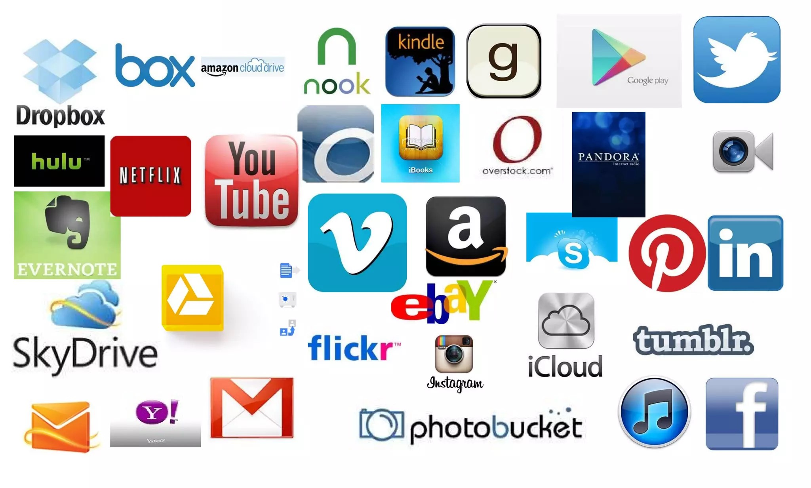
Have you tried Cloud (examples)?

Slide 12
Thank You.
Chandi Charan Mahato
Anurag Varshney
Divyanshu Gupta
Harish
Professional Communication Lab
Galgotias College Of Engineering and Technology

